Slide 1
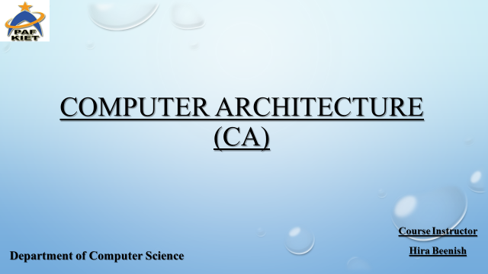

Slide 2
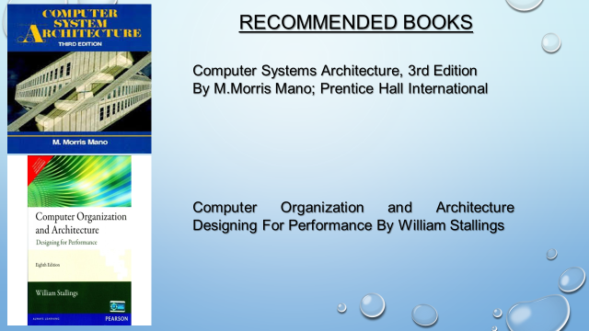

Slide 3
Memory Management
Chapter 7

Slide 4
Memory Management
Is the task carried out by the OS and hardware to accommodate multiple processes in main memory
If only a few processes can be kept in main memory, then much of the time all processes will be waiting for I/O and the CPU will be idle
Hence, memory needs to be allocated efficiently in order to pack as many processes into memory as possible

Slide 5
Memory Management
In most schemes, the kernel occupies some fixed portion of main memory and the rest is shared by multiple processes

Slide 6
Memory Management Requirements
Relocation
  programmer cannot know where the program will be placed in memory when it is executed
  a process may be (often) relocated in main memory due to swapping
  swapping enables the OS to have a larger pool of ready-to-execute processes
  memory references in code (for both instructions and data) must be translated to actual physical memory address

Slide 7
Memory Management Requirements
Protection
  processes should not be able to reference memory locations in another process without permission
  impossible to check addresses at compile time in programs since the program could be relocated
  address references must be checked at run time by hardware

Slide 8
Memory Management Requirements
Sharing
  must allow several processes to access a common portion of main memory without compromising protection
    cooperating processes may need to share access to the same data structure
    better to allow each process to access the same copy of the program rather than have their own separate copy

Slide 9
Memory Management Requirements
Logical Organization
  users write programs in modules with different characteristics
    instruction modules are execute-only
    data modules are either read-only or read/write
    some modules are private others are public
  To effectively deal with user programs, the OS and hardware should support a basic form of module to provide the required protection and sharing

Slide 10
Memory Management Requirements
Physical Organization
  secondary memory is the long term store for programs and data while main memory holds program and data currently in use
  moving information between these two levels of memory is a major concern of memory management (OS)
    it is highly inefficient to leave this responsibility to the application programmer

Slide 11
Simple Memory Management
In this chapter we study the simpler case where there is no virtual memory
An executing process must be loaded entirely in main memory (if overlays are not used)
Although the following simple memory management techniques are not used in modern OS, they lay the ground for a proper discussion of virtual memory (next chapter)
  fixed partitioning
  dynamic partitioning
  simple paging
  simple segmentation

Slide 12
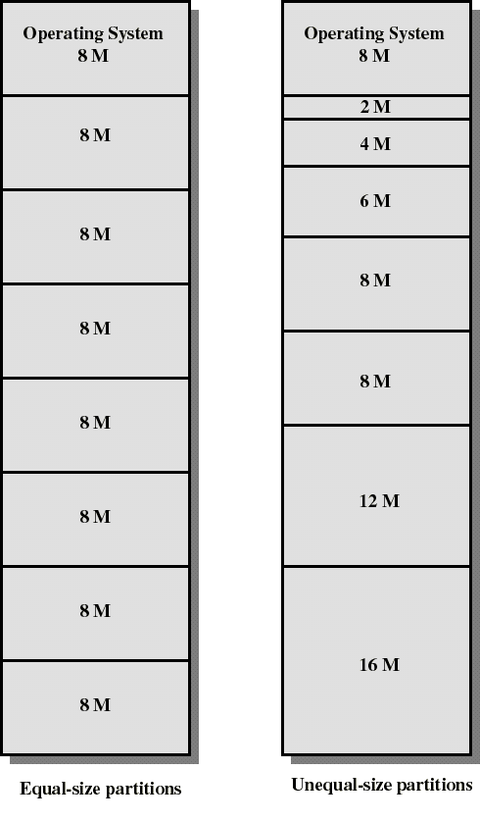
Fixed Partitioning
Partition main memory into a set of non overlapping regions called partitions
Partitions can be of equal or unequal sizes

Slide 13
Fixed Partitioning
any process whose size is less than or equal to a partition size can be loaded into the partition
if all partitions are occupied, the operating system can swap a process out of a partition
a program may be too large to fit in a partition. The programmer must then design the program with overlays
  when the module needed is not present the user program must load that module into the program’s partition, overlaying whatever program or data are there

Slide 14
Fixed Partitioning
Main memory use is inefficient. Any program, no matter how small, occupies an entire partition. This is called internal fragmentation.
Unequal-size partitions lessens these problems but they still remain...
Equal-size partitions was used in early IBM’s OS/MFT (Multiprogramming with a Fixed number of Tasks)

Slide 15
Placement Algorithm with Partitions
Equal-size partitions
  If there is an available partition, a process can be loaded into that partition
    because all partitions are of equal size, it does not matter which partition is used
  If all partitions are occupied by blocked processes, choose one process to swap out to make room for the new process

Slide 16
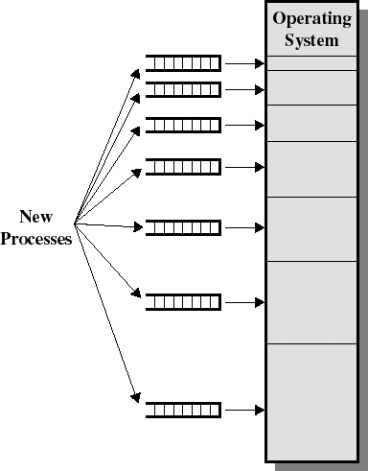
Placement Algorithm with Partitions
Unequal-size partitions: use of multiple queues
  assign each process to the smallest partition within which it will fit
  A queue for each partition size
  tries to minimize internal fragmentation
  Problem: some queues will be empty if no processes within a size range is present

Slide 17
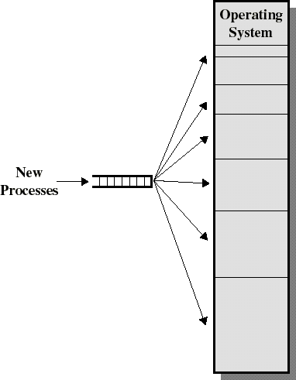
Placement Algorithm with Partitions
Unequal-size partitions: use of a single queue
  When its time to load a process into main memory the smallest available partition that will hold the process is selected
  increases the level of multiprogramming at the expense of internal fragmentation

Slide 18
Dynamic Partitioning
Partitions are of variable length and number
Each process is allocated exactly as much memory as it requires
Eventually holes are formed in main memory. This is called external fragmentation
Must use compaction to shift processes so they are contiguous and all free memory is in one block
Used in IBM’s OS/MVT (Multiprogramming with a Variable number of Tasks)

Slide 19
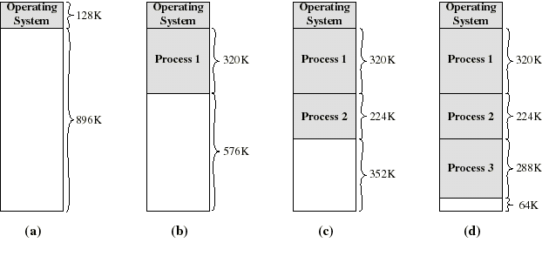
Dynamic Partitioning: an example
A hole of 64K is left after loading 3 processes: not enough room for another process
Eventually each process is blocked. The OS swaps out process 2 to bring in process 4

Slide 20
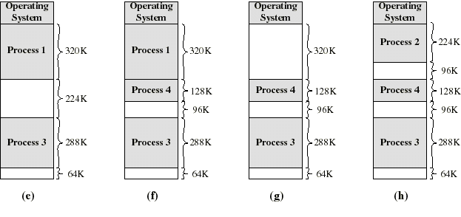
Dynamic Partitioning: an example
another hole of 96K is created
Eventually each process is blocked. The OS swaps out process 1 to bring in again process 2 and another hole of 96K is created...
Compaction would produce a single hole of 256K

Slide 21
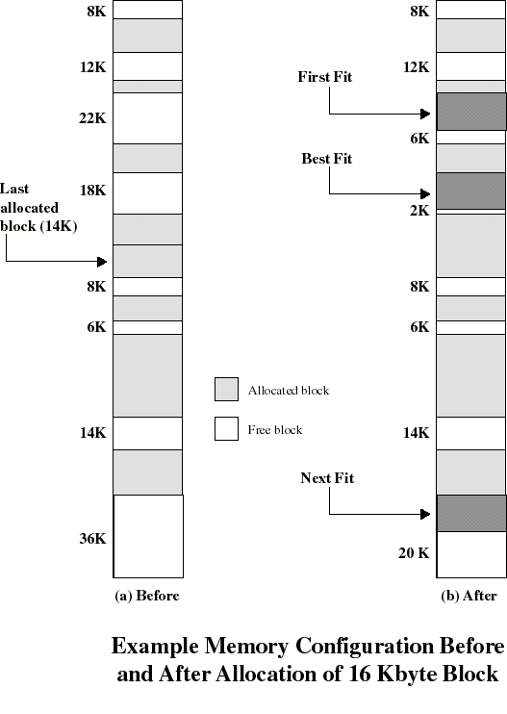
Placement Algorithm
Used to decide which free block to allocate to a process
Goal: to reduce usage of compaction (time consuming)
Possible algorithms:
  Best-fit: choose smallest hole
  First-fit: choose first hole from beginning
  Next-fit: choose first hole from last placement

Slide 22
Placement Algorithm: comments
Next-fit often leads to allocation of the largest block at the end of memory
First-fit favors allocation near the beginning: tends to create less fragmentation then Next-fit
Best-fit searches for smallest block: the fragment left behind is small as possible
  main memory quickly forms holes too small to hold any process: compaction generally needs to be done more often

Slide 23
Replacement Algorithm
When all processes in main memory are blocked, the OS must choose which process to replace
  A process must be swapped out (to a Blocked-Suspend state) and be replaced by a new process or a process from the Ready-Suspend queue
  We will discuss later such algorithms for memory management schemes using virtual memory

Slide 24
Relocation
Because of swapping and compaction, a process may occupy different main memory locations during its lifetime
Hence physical memory references by a process cannot be fixed
This problem is solved by distinguishing between logical address and physical address

Slide 25
Address Types
A physical address (absolute address) is a physical location in main memory
A logical address is a reference to a memory location independent of the physical structure/organization of memory
Compilers produce code in which all memory references are logical addresses
A relative address is an example of logical address in which the address is expressed as a location relative to some known point in the program (ex: the beginning)

Slide 26
Address Translation
Relative address is the most frequent type of logical address used in pgm modules (ie: executable files)
Such modules are loaded in main memory with all memory references in relative form
Physical addresses are calculated “on the fly” as the instructions are executed
For adequate performance, the translation from relative to physical address must by done by hardware

Slide 27
Simple example of hardware translation of addresses
When a process is assigned to the running state, a base register (in CPU) gets loaded with the starting physical address of the process
A bound register gets loaded with the process’s ending physical address
When a relative addresses is encountered, it is added with the content of the base register to obtain the physical address which is compared with the content of the bound register
This provides hardware protection: each process can only access memory within its process image

Slide 28
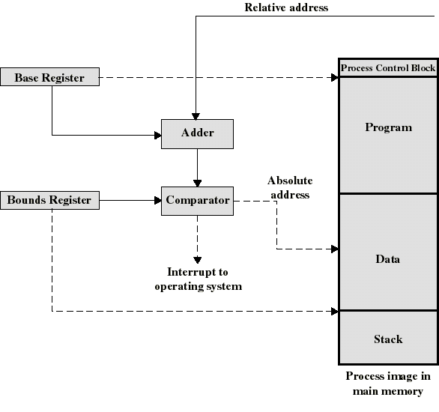
Example Hardware for Address Translation

Slide 29
Simple Paging
Main memory is partition into equal fixed-sized chunks (of relatively small size)
Trick: each process is also divided into chunks of the same size called pages
The process pages can thus be assigned to the available chunks in main memory called frames (or page frames)
Consequence: a process does not need to occupy a contiguous portion of memory

Slide 30
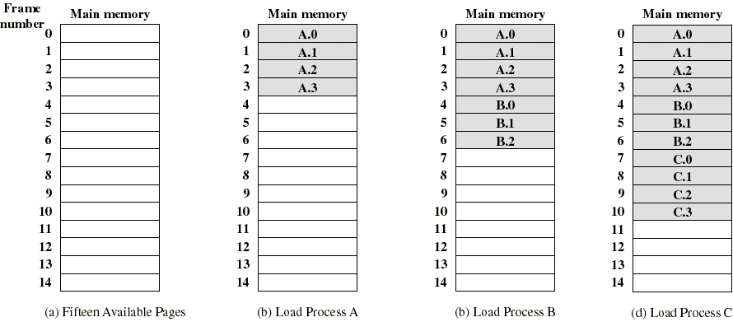
Example of process loading
Now suppose that process B is swapped out

Slide 31
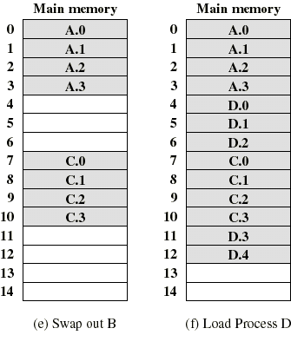
Example of process loading (cont.)
When process A and C are blocked, the pager loads a new process D consisting of 5 pages
Process D does not occupied a contiguous portion of memory
There is no external fragmentation
Internal fragmentation consist only of the last page of each process

Slide 32
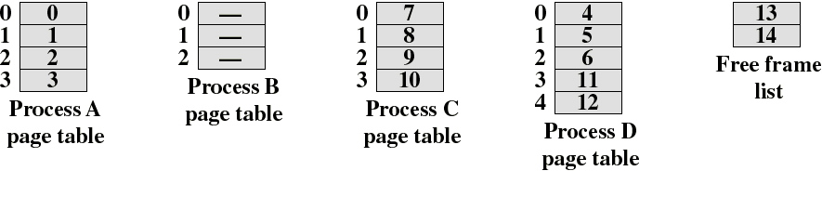
Page Tables
The OS now needs to maintain (in main memory) a page table for each process
Each entry of a page table consist of the frame number where the corresponding page is physically located
The page table is indexed by the page number to obtain the frame number
A free frame list, available for pages, is maintained

